Slide 1
The Battle of Neighbourhoods

Slide 2
If a person wants to move from New York to Toronto, battle of neighbourhoods gives similarities between the venues and similar places in Toronto as compared to his current location New York. We create a system that helps the user to find our similar localities in Toronto similar like New York
Objective

Slide 3
Methodology
The location or neibourhoods are downloaded for each TO and NY cities
The Venues are requested with Four Square APIs
Categories are encoded with One Hot Encoding
K means algorithm is used to find the elbow and then group them into similarities or clusters

Slide 4
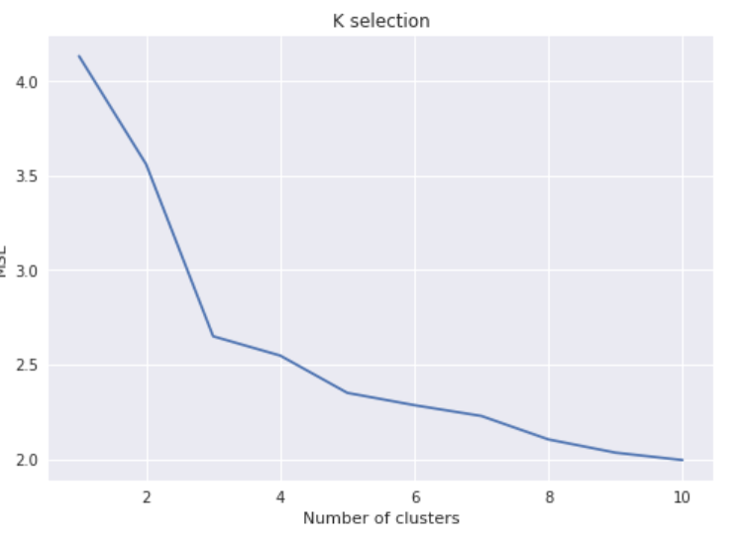
K means – selection . K= 5

Slide 5
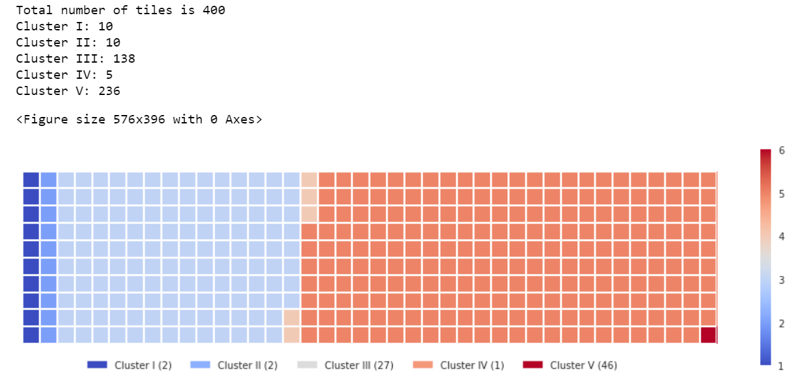
Waffle chart – Data segmentation

Slide 6
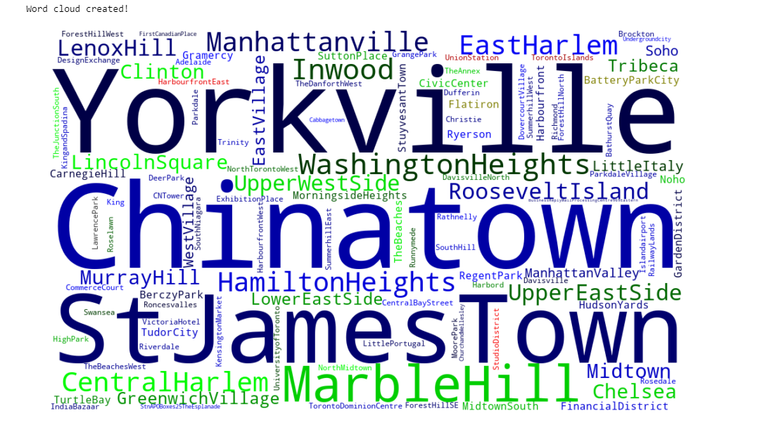
Word Cloud – Segmentation wrt colors

Slide 7
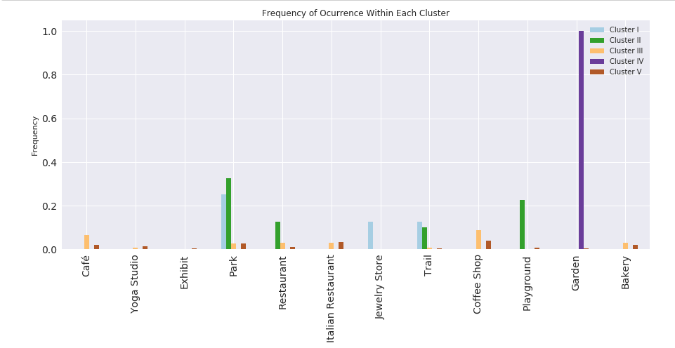
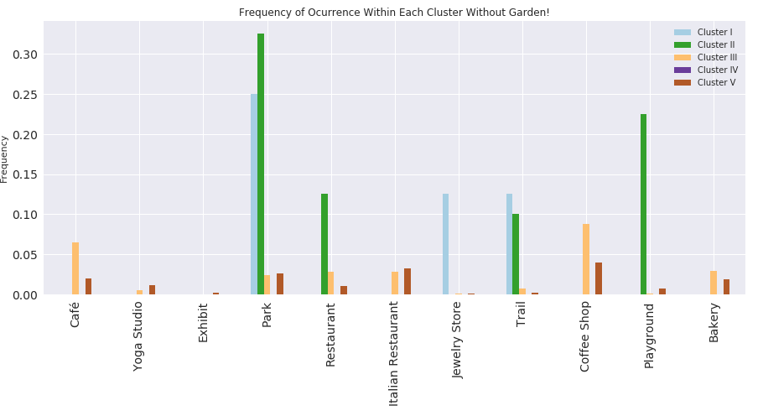
Frequency of occurrence as per clusters

Slide 8
Conclusion
Cluster 1 – Parks, trails, Jewellery stores
Cluster 2 – Parks, playgrounds, restaurants, trails
Cluster 3 – Cafe, Coffee shops, Bakeries
Cluster 4 – Only Garden
Cluster 5 – Italian restaurants, coffee shops, bakeries, parks

